Slide 1
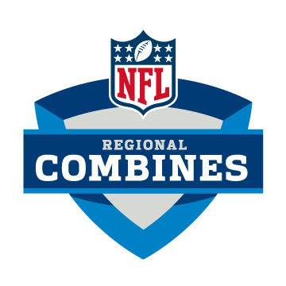
Measuring NFL success by NFL Combine results
By: Joe Cheng
Giovanni Rigters
Lucy Hohler

Slide 2
What is the NFL Combine?
The NFL combine is an invitational event to test NFL prospects on their athletic ability
General Managers, Scouts and Personal Executives evaluate combine participants on their speed, power, agility, strength, and explosiveness as it relates to size
Each drill has a practical application for the movements these players are going to have to make on the field

Slide 3
Objectives
The purpose of this project is to see if there is a correlation between the combine drill results and NFL success
We will look at 5+ years worth of combine data to test our results. To measure “success”; we will use pro bowl appearances
Our primary goal is to identify a correlation between drill performance and NFL pro bowl appearances
Our secondary goal is to identify what combination of drills for each position will most accurately predict future NFL success

Slide 4
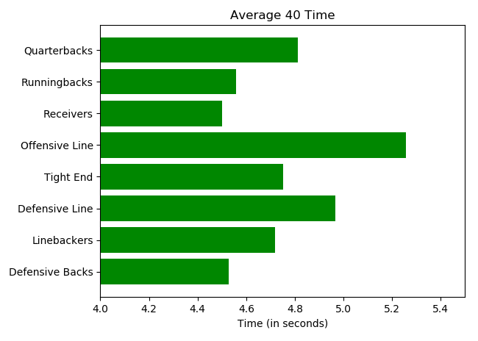
NFL Combine Drills – 40 Yard Dash
What does it measures?
Straight line-speed
Break-away ability

Slide 5
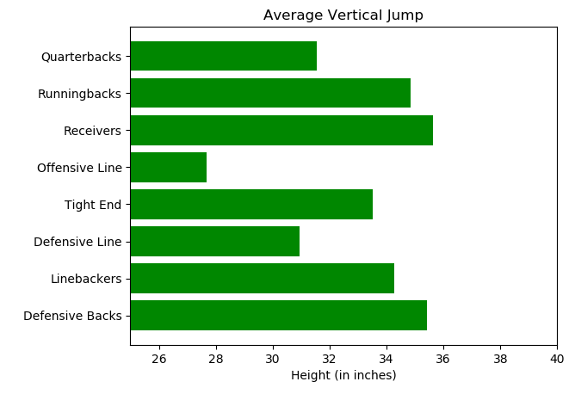
NFL Combine Drills – Vertical Jump
What does it measures?
Leaping ability
Explosiveness

Slide 6
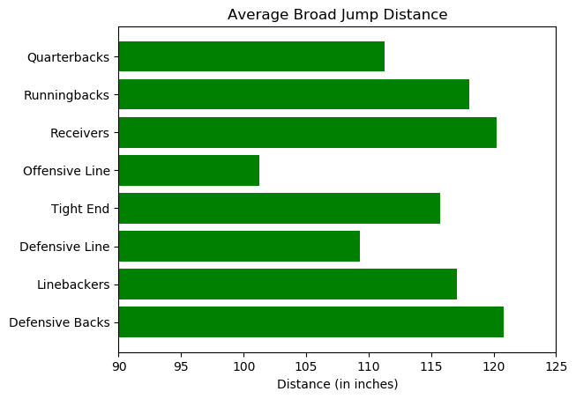
NFL Combine Drills – Broad Jump
What does it measures?
Lower-body power
Balance
Flexibility
Explosiveness

Slide 7
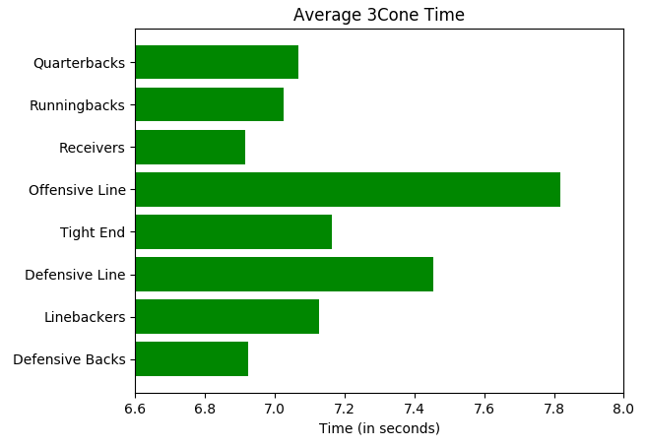
NFL Combine Drills – Three-Cone Drill
What does it measures?
Lateral agility
Change of direction
Acceleration
Coordination

Slide 8
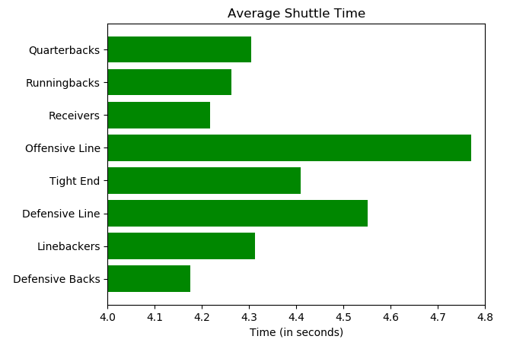
NFL Combine Drills – Shuttle
What does it measures?
Ability to change direction
Maintain balance
Acceleration
Short-area quickness

Slide 9
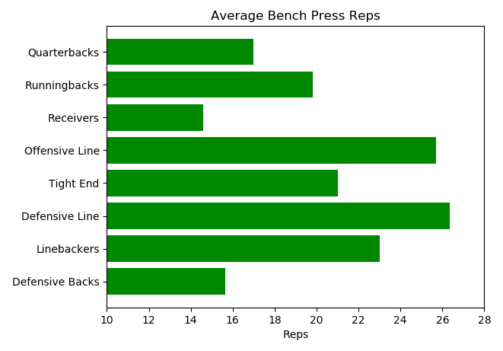
NFL Combine Drills – Bench
What does it measures?
Strength
Power

Slide 10
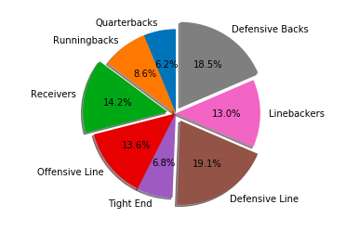
Our analytical approach
We looked at positional matchups for each analytical graph
For the analytical process; we used scatter plots to find the most prominent drills
Why?
1 combine drill result does not tell the whole story of athletic ability
We tried to use a 2 drill basis and find which 2 drills reflected most on the athletic ability needed to succeed at each position

Slide 11
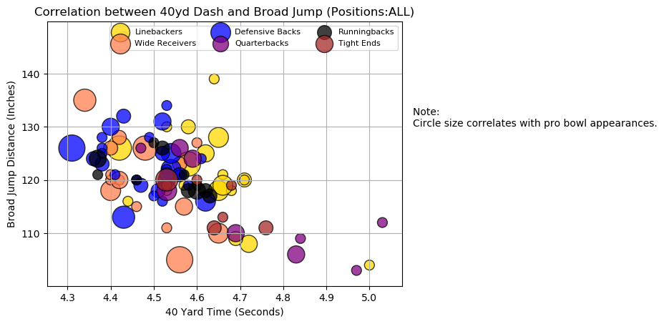
General Athleticism

Slide 12
Conclusion
Broad Jump and 40 YD dash were found to be the most accurate measurement of the minimum athletic ability for ALL positions to ‘succeed’ in the NFL.
We see the most success is at the 120 to 130 broad jump range distance paired with a minimum of a 4.6 second 40 YD dash gave us the best portrayal of the minimum athletic ability to succeed in the NFL.

Slide 13
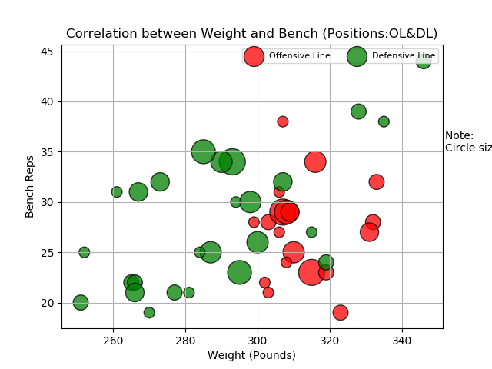
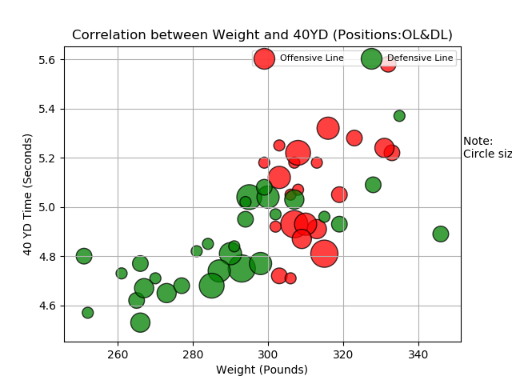
Defensive Line and Offensive Line

Slide 14
Conclusion
Defensive line prospects weight does not matter as significant as for offensive line prospects.
Defensive line prospects weight can be overcome by a faster 40 YD time, vice versa a slow 40 YD time can be overcome by pure weight
Bench reps are a good parameter of success for offensive line prospects; the 25 to 30 range seemed to be where the most success was coupled with a weight range of 300+ minimum

Slide 15
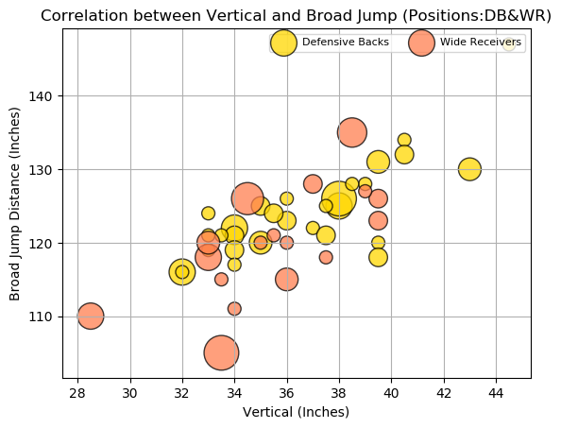
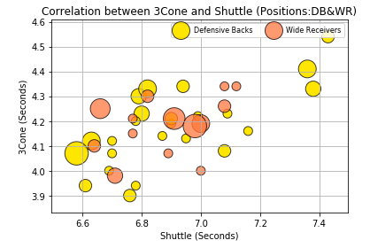
Defensive backs and Receivers

Slide 16
Conclusions
We are seeing the most success at a range of 120 to 130 broad jump distance paired with a minimum vertical of 34 inches.
On the receiver side, we focused on finding out what was more important; straight line speed or quickness. Our findings concluded that the more accurate portrayal was tested through quickness drills such as the 3cone and shuttle more so VS the 40 yard.
We see a 7 second maximum on the 3 cone and a 4.3 second maximum on the shuttle gave us a good parameter for success

Slide 17
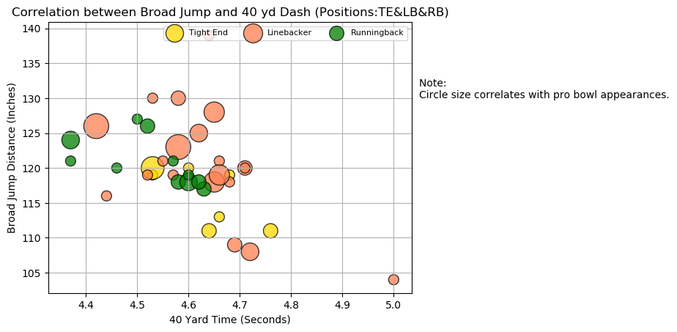
Running backs / Tight Ends / Linebackers

Slide 18
Conclusion
We see the general parameters here are a 115 to 120 broad jump range and a 4.7 second maximum 40 yard dash.
For the running backs, we see that a good ideal benchmark is at the 4.5 second mark for the 40, but success can be found at the 4.6 second mark.
For the linebackers, we see that the broad jump seems to factor in quite a bit, as they are one of the more higher results we have seen. There is a good benchmark of success at the 125+ mark.
The years we chose to study did not have a good representation of tight ends, but from the data given we can see that the broad jump is NOT a good parameter of success for the position, tight ends being the outlier on the case of using broad jump as a measurement for success.

Slide 19
List of issues we ran into
Initial data given had special characters such as (% and +) within the strings of texts
Solution | Created a code that found special characters and removed them from the text string
Initial data given was converting heights such as (6"4) into dates
Solution | Created a code that took dates and converted them back in height format
Initial data given had multiple positions (DE,DT,OLB,MLB,FS,SS,CB), we wanted a more specific category of positions
Solution | Created a code that found each position we wanted to convert (DE&OLB) to our method of categorizing (DL&LB)
Initial data had excess rows of non information that crashed our codes
Solution | Created a code that removed the rows that did not have pertinent information

Slide 20
Limitations and flaws of our approach
We are not accounting for statistical performance in college; we are only measuring athletic ability, athletic ability is not the absolute towards NFL success
Our findings are limited to the 5 years we chose to study over (2010 to 2015)
Combine results are more skewed towards positions that prioritize pure athleticism over more skill based positions such as Quarterback
Our chosen option to measure "success" were pro bowl appearances; what "success" is can be looked at many different ways and pro bowl appearances are not the say all to "succeed" in the NFL
Pro bowl appearances are more limited for skill positions such as Quarterback. Teams only have 1 quarterback, where as they have multiple receivers, multiple offensive line, so for our method of "success" it once again hurts quarterbacks
We do not take into account a combination of weight/height; for example, a 6”5 225+ running a 4.5 40 is more impressive than a 5”10 180 running a 4.5 40.

Slide 21
Conclusions
Broad Jump is the most useful general drill that translates into NFL success
Throughout all the data we plotted; we came to the conclusion that NFL combine drills are virtually useless towards the Quarterback position. There is currently no combine drill that accurately reflects what a quarterback needs to do to "succeed" in the NFL.
Wide Receivers\Defensive Backs\Defensive Line are the positions that combine drills matter the most to "succeed" in the NFL. In other words, pure athleticism are more needed in these positions more so than any other position
Contrary to popular belief; quickness (Shuttle&3Cone) were more accurate representations rather than straight line speed (40 Yard) in overall success for Wide Receivers
Defensive backs were far and away the most athletically gifted in comparison to all other positions. It is not a stretch to say they are the most athletically demanding position in the NFL.
Defensive line prospects were the only position that showed that lacking in one area could be compensated by excelling in another (IE, where they lacked in weight, they made up in pure speed vice versa)

Slide 22
Questions?

